Slide 1
Conceptual Design Review
Ryan Brown, Corinne Smith, Ryan Yount, Alex Toth

Slide 2
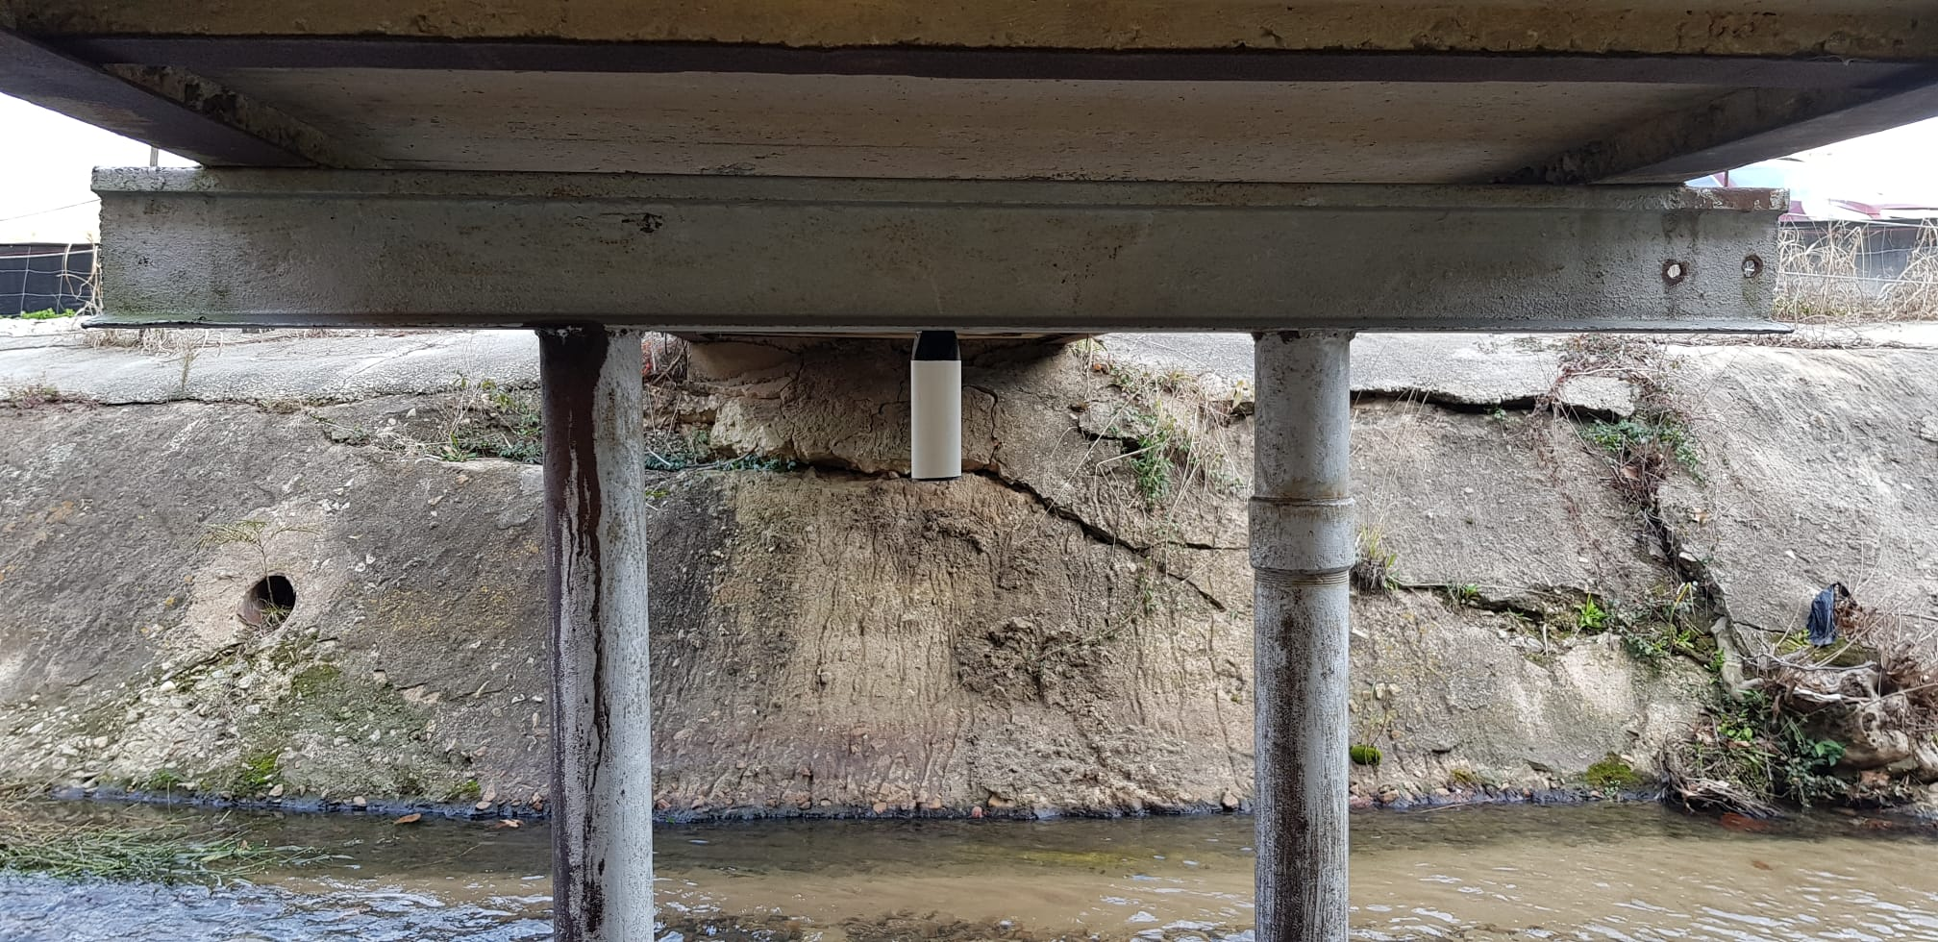
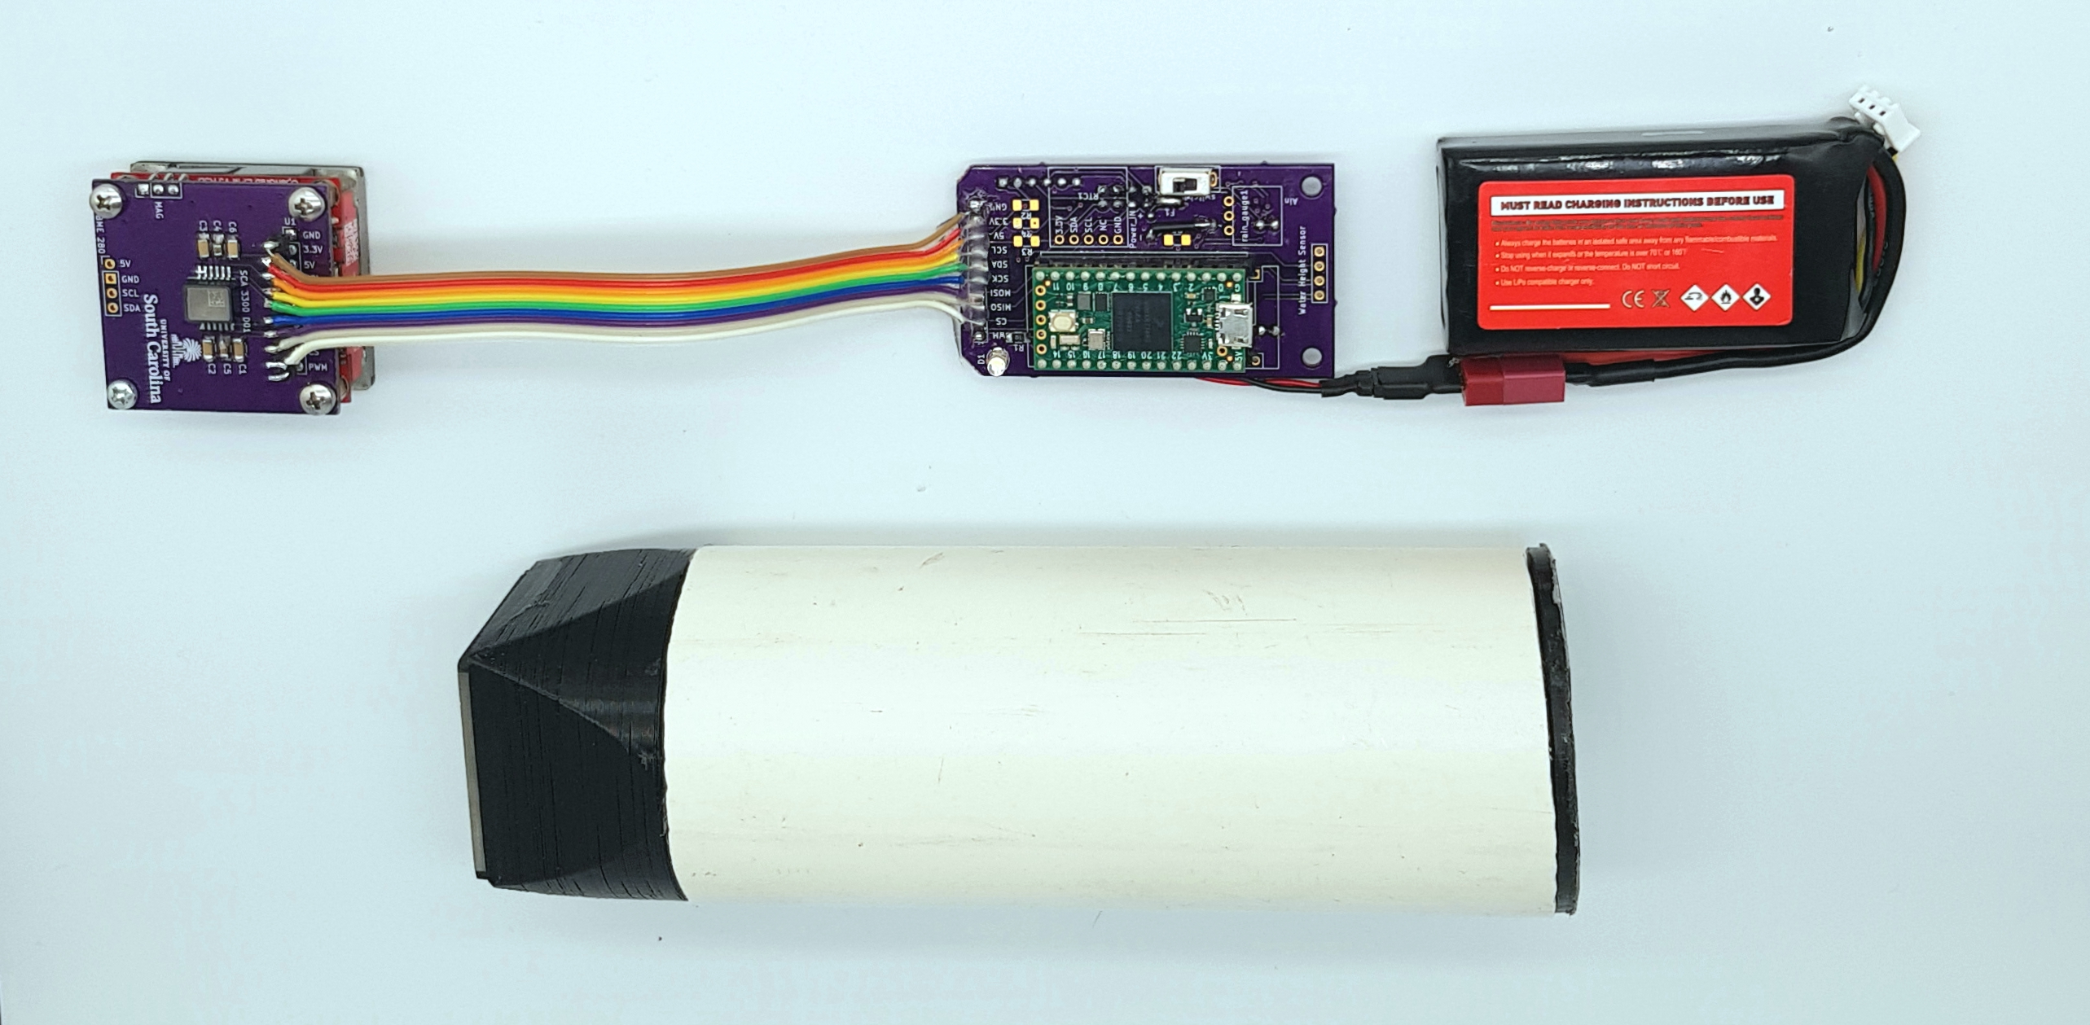
Project Background
Company Name: Adaptive Real-Time Systems (ARTS) Laboratory
Project Sponsor: Dr. Austin R.J. Downey
Our motivation:
The ARTS Lab is developing a sensor package to measure vibrations in bridges
A shaker is needed to excite the bridge to determine mode shapes
Shakers in the ARTS Lab now are too small to excite large structures
Impulse testing has been performed on bridges, but continuous testing is desired
Continuous testing allows for testing different frequencies
Continuous testing permits excitement to more modes
Our purpose: create a shaker for continuous bridge vibration testing using the ARTS Lab sensor package
Our objectives:
Identify customer needs, project specifications, and product functionality
Design viable shakers for continuous testing of vibration data
Build and test a final design for the shaker to deliver to the ARTS Lab

Slide 3
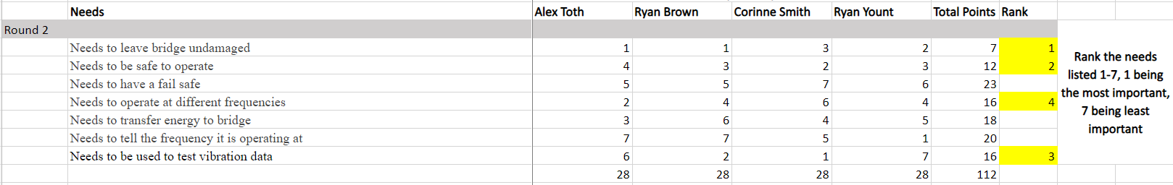
Needs
Needs Interpretation
Initial brainstormed needs
36 needs identified
Prioritization of Needs
Round 1
50 points per person to vote an all 36 needs
Top 7 moved on to round 2
Round 2
Priority ranking (low numbers mean high priority)
1 is highest, 7 is lowest
Top 4 became the product mission

Slide 4
Needs
Needs to be used to test vibration data
Needs to ideally excite the fourth or fifth mode
Needs to have a max range based on experimental data gathered by accelerometers
Needs to be robust
Needs to be usable after we leave
Needs to be site flexible
Needs to be portable
Needs to be user friendly
Needs to run off a portable power supply
Needs to tell the frequency it is operating at (3)
Needs to have feedback control
Needs to have a screen to monitor parameters
Needs to transfer energy to bridge
Needs to have high efficiency
Needs to have good contact to bridge
Needs to not damage the bridge (1)
Needs to be minimally invasive
Needs to be small enough to not affect vibration data
Need accelerometers to capture very high/low frequencies for validation
Needs user controllable speed
Needs to be replicable by other researchers
Needs to be easily reparable
Needs to be cost-effective
Needs to withstand the stress of operation
Needs to record data
Needs to be aesthetically pleasing
Needs to operate at different frequencies (4)
Needs a resolution of at least 1 Hz
Needs to be power efficient
Needs to be validated with data at different times of day
Needs to operate in a variety of temperatures
Needs to be well documented (GitHub repository)
Needs to have clear operation instructions
Needs to be safe to operate (2)
Needs to have a fail safe
Needs to have a time control

Slide 5
MISSION STATEMENT
Dr. Austin Downey and stakeholders require a bridge shaker that needs to test vibration data, operate at different frequencies, be safe to operate, and leave the bridge undamaged.

Slide 6
Specifications
Needs are narrowed down to eliminate redundancies
2. Metrics are assigned to evaluate each need's performance
3. Importance factors and correlation coefficients are assigned to each need and metric
4. Target and fallback specifications are set for each metric
5. Key needs, metrics, and parameters are identified

Slide 7
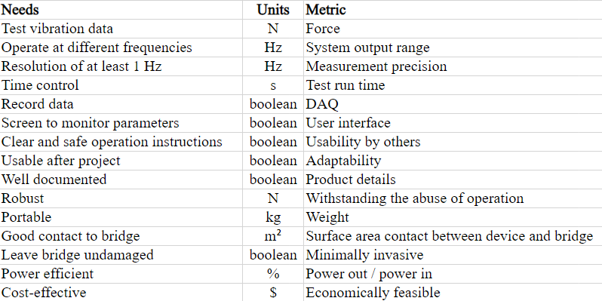
Needs Matrix

Slide 8
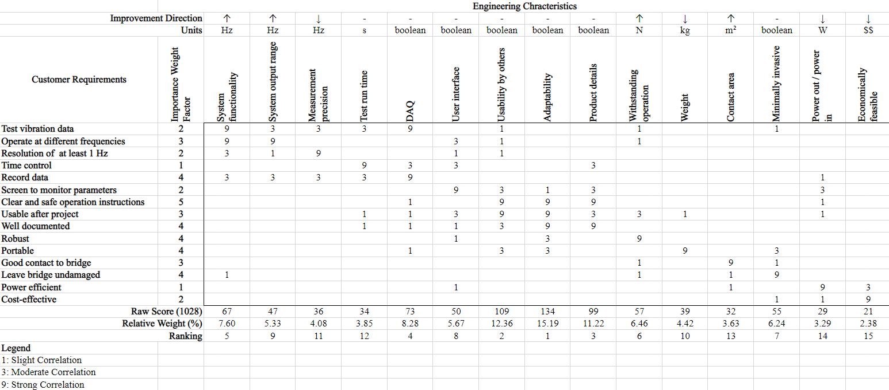
Needs Metrics Matrix

Slide 9
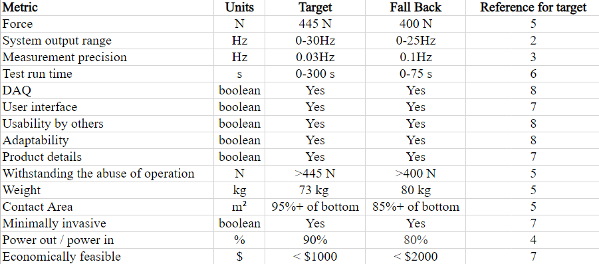
Target/Fallback Specifications

Slide 10
Specifications Takeaways
Key needs:
Clear and safe operation instructions
Well-documented
Robust
Portable
Leave bridge undamaged
Key metrics:
Adaptability
Usability by others
Product details
Critical tradeoffs:
Robustness vs portability
Contact to bridge vs leaving the bridge undamaged

Slide 11
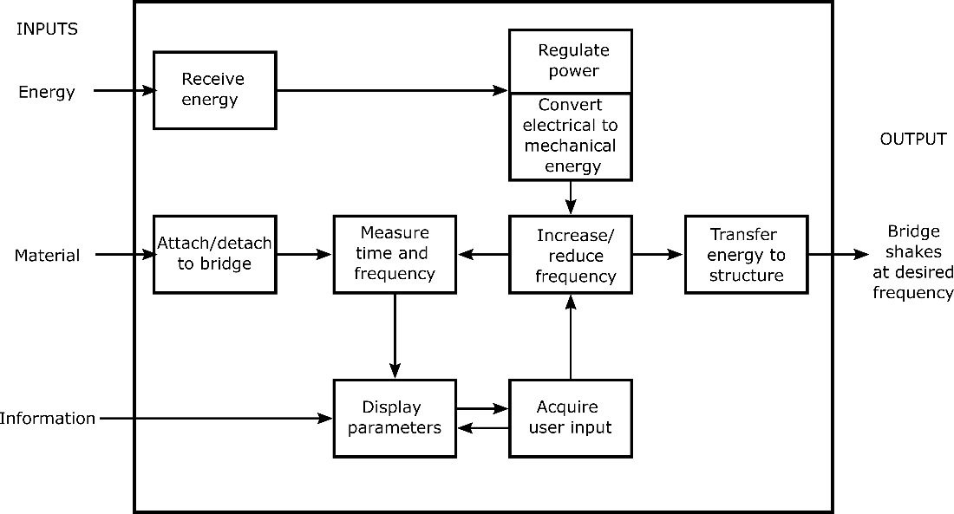
Functional Decomposition
Determining what a product will do and how it will accomplish it
A variety of ideas were put together to create the functions of the finished product

Slide 12
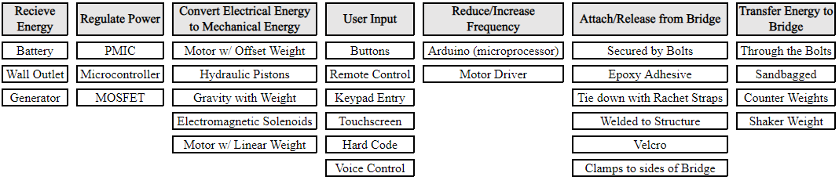
Concept Combination
Organize the possible solutions of the functional requirements
Each function from the function diagram was designated several different ways to implement a realistic solution

Slide 13
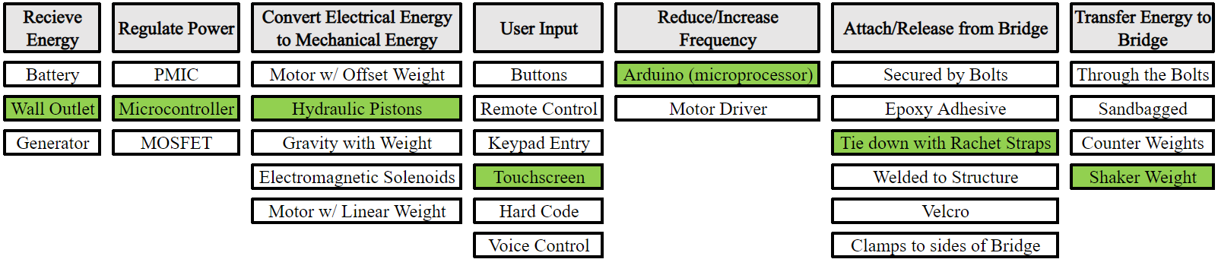
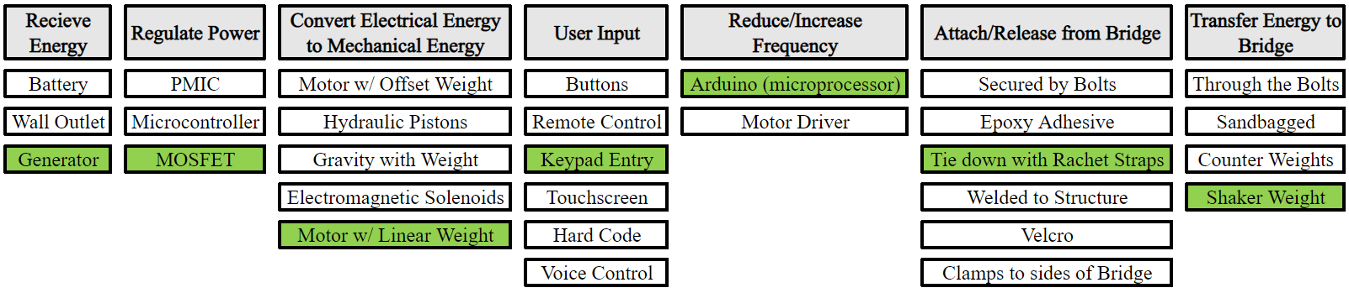
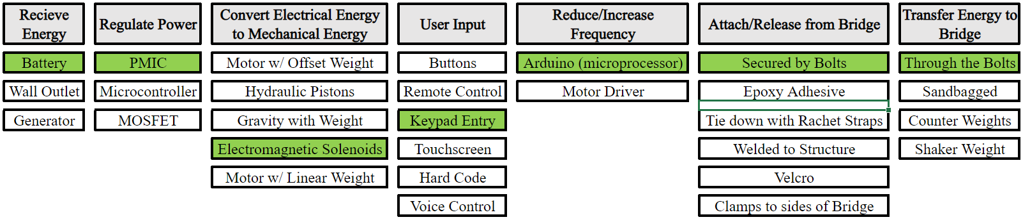
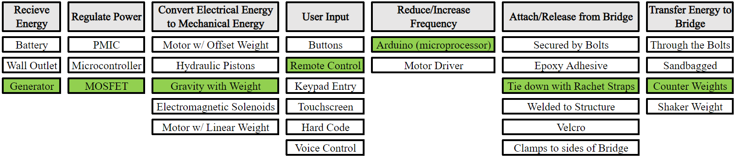
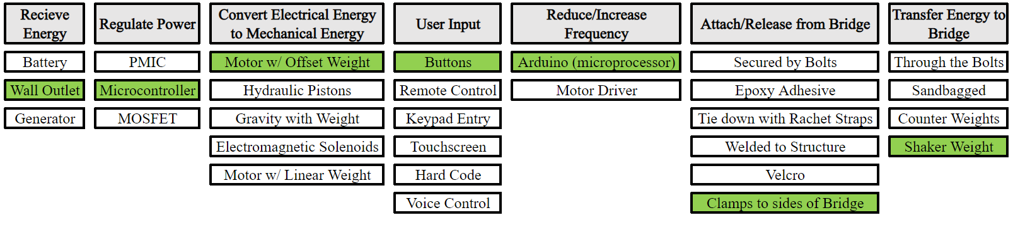
Concept Combination
Concepts were generated using one solution for each function in an order that still made sense logically
The team voted on these ideas collaboratively, deciding on feasible solutions for the product
Five concepts were generated using the CCT

Slide 14
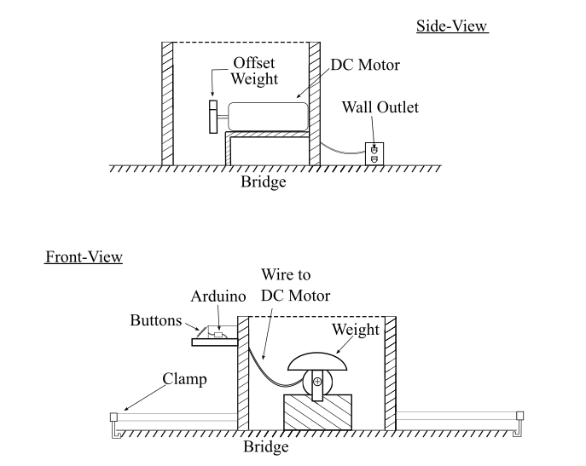
Concept 1
Strengths:
Leaves bridge undamaged
Robustness
Weaknesses:
Operation at different frequencies
Resolution of at least 1 Hz

Slide 15
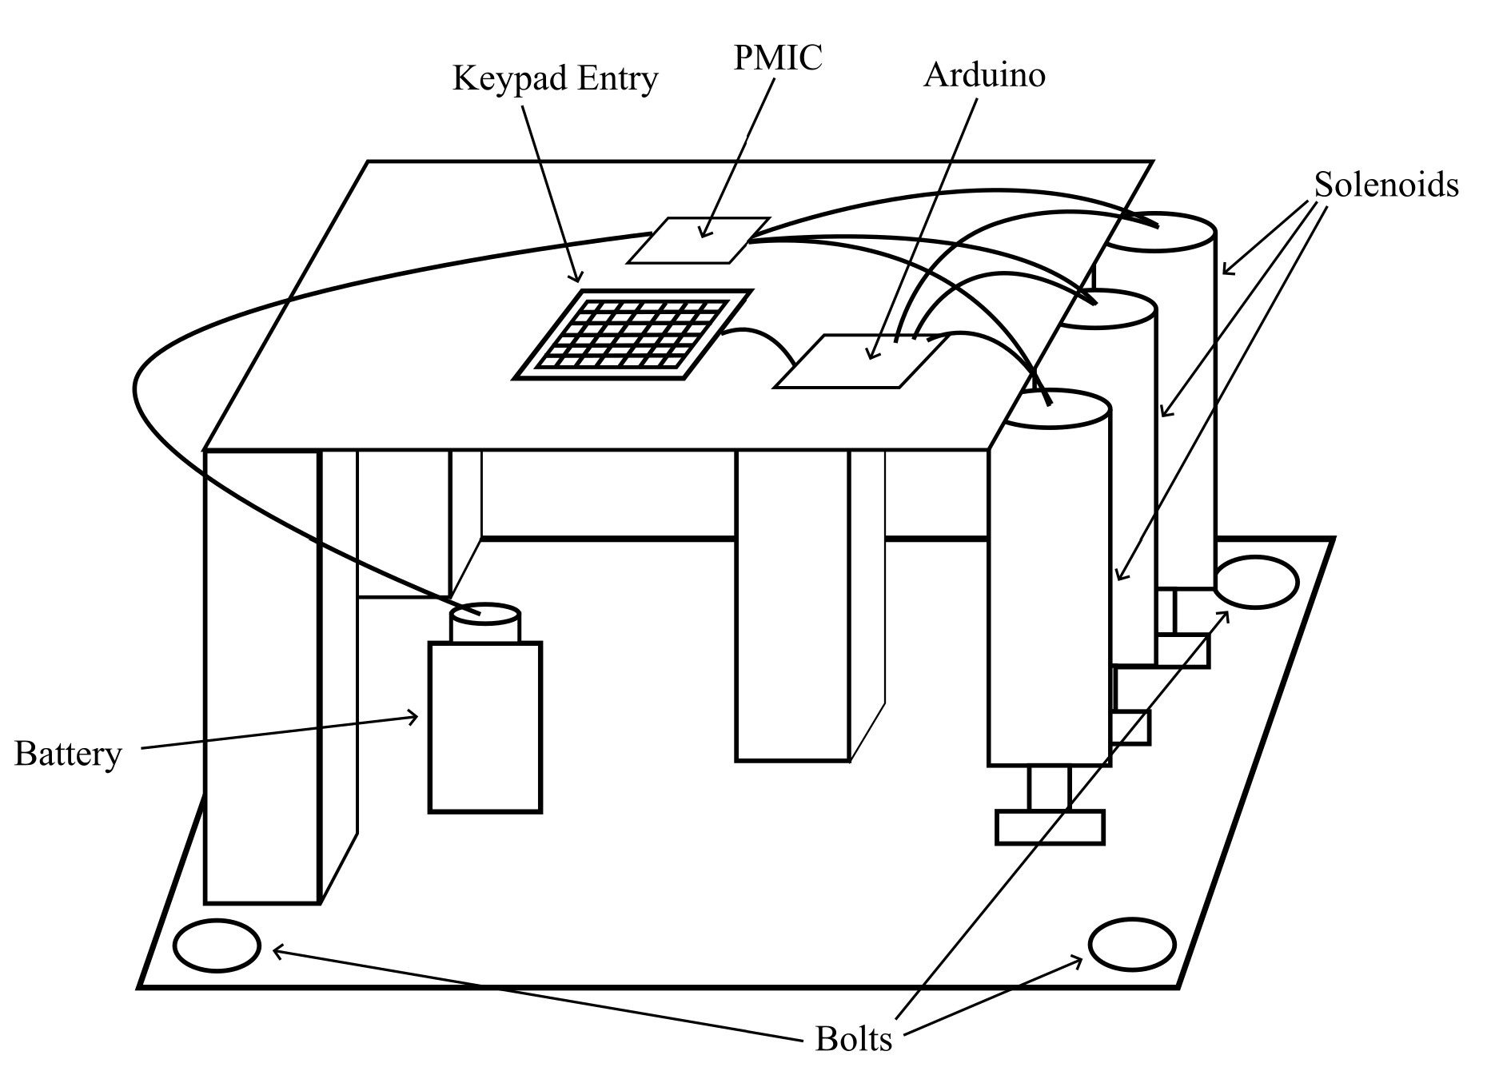
Concept 2
Strengths:
Operation at different frequencies
Clear and safe operation
Weaknesses:
Portability
Contact to bridge
Cost-effectiveness

Slide 16
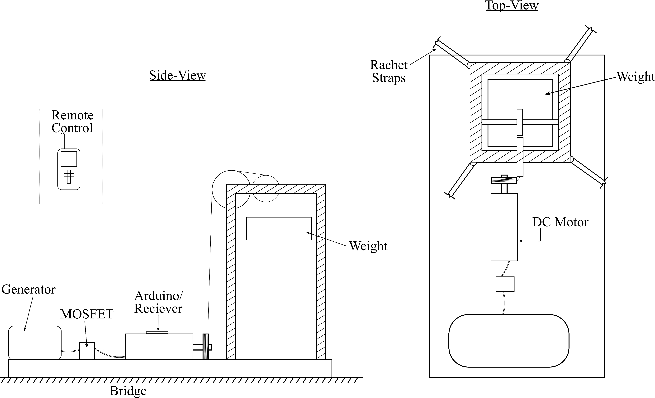
Concept 3
Strengths:
Contact to bridge
Power efficiency
Weaknesses:
Clear and safe operation
Operation at different frequencies
Leave bridge undamaged
Robustness

Slide 17
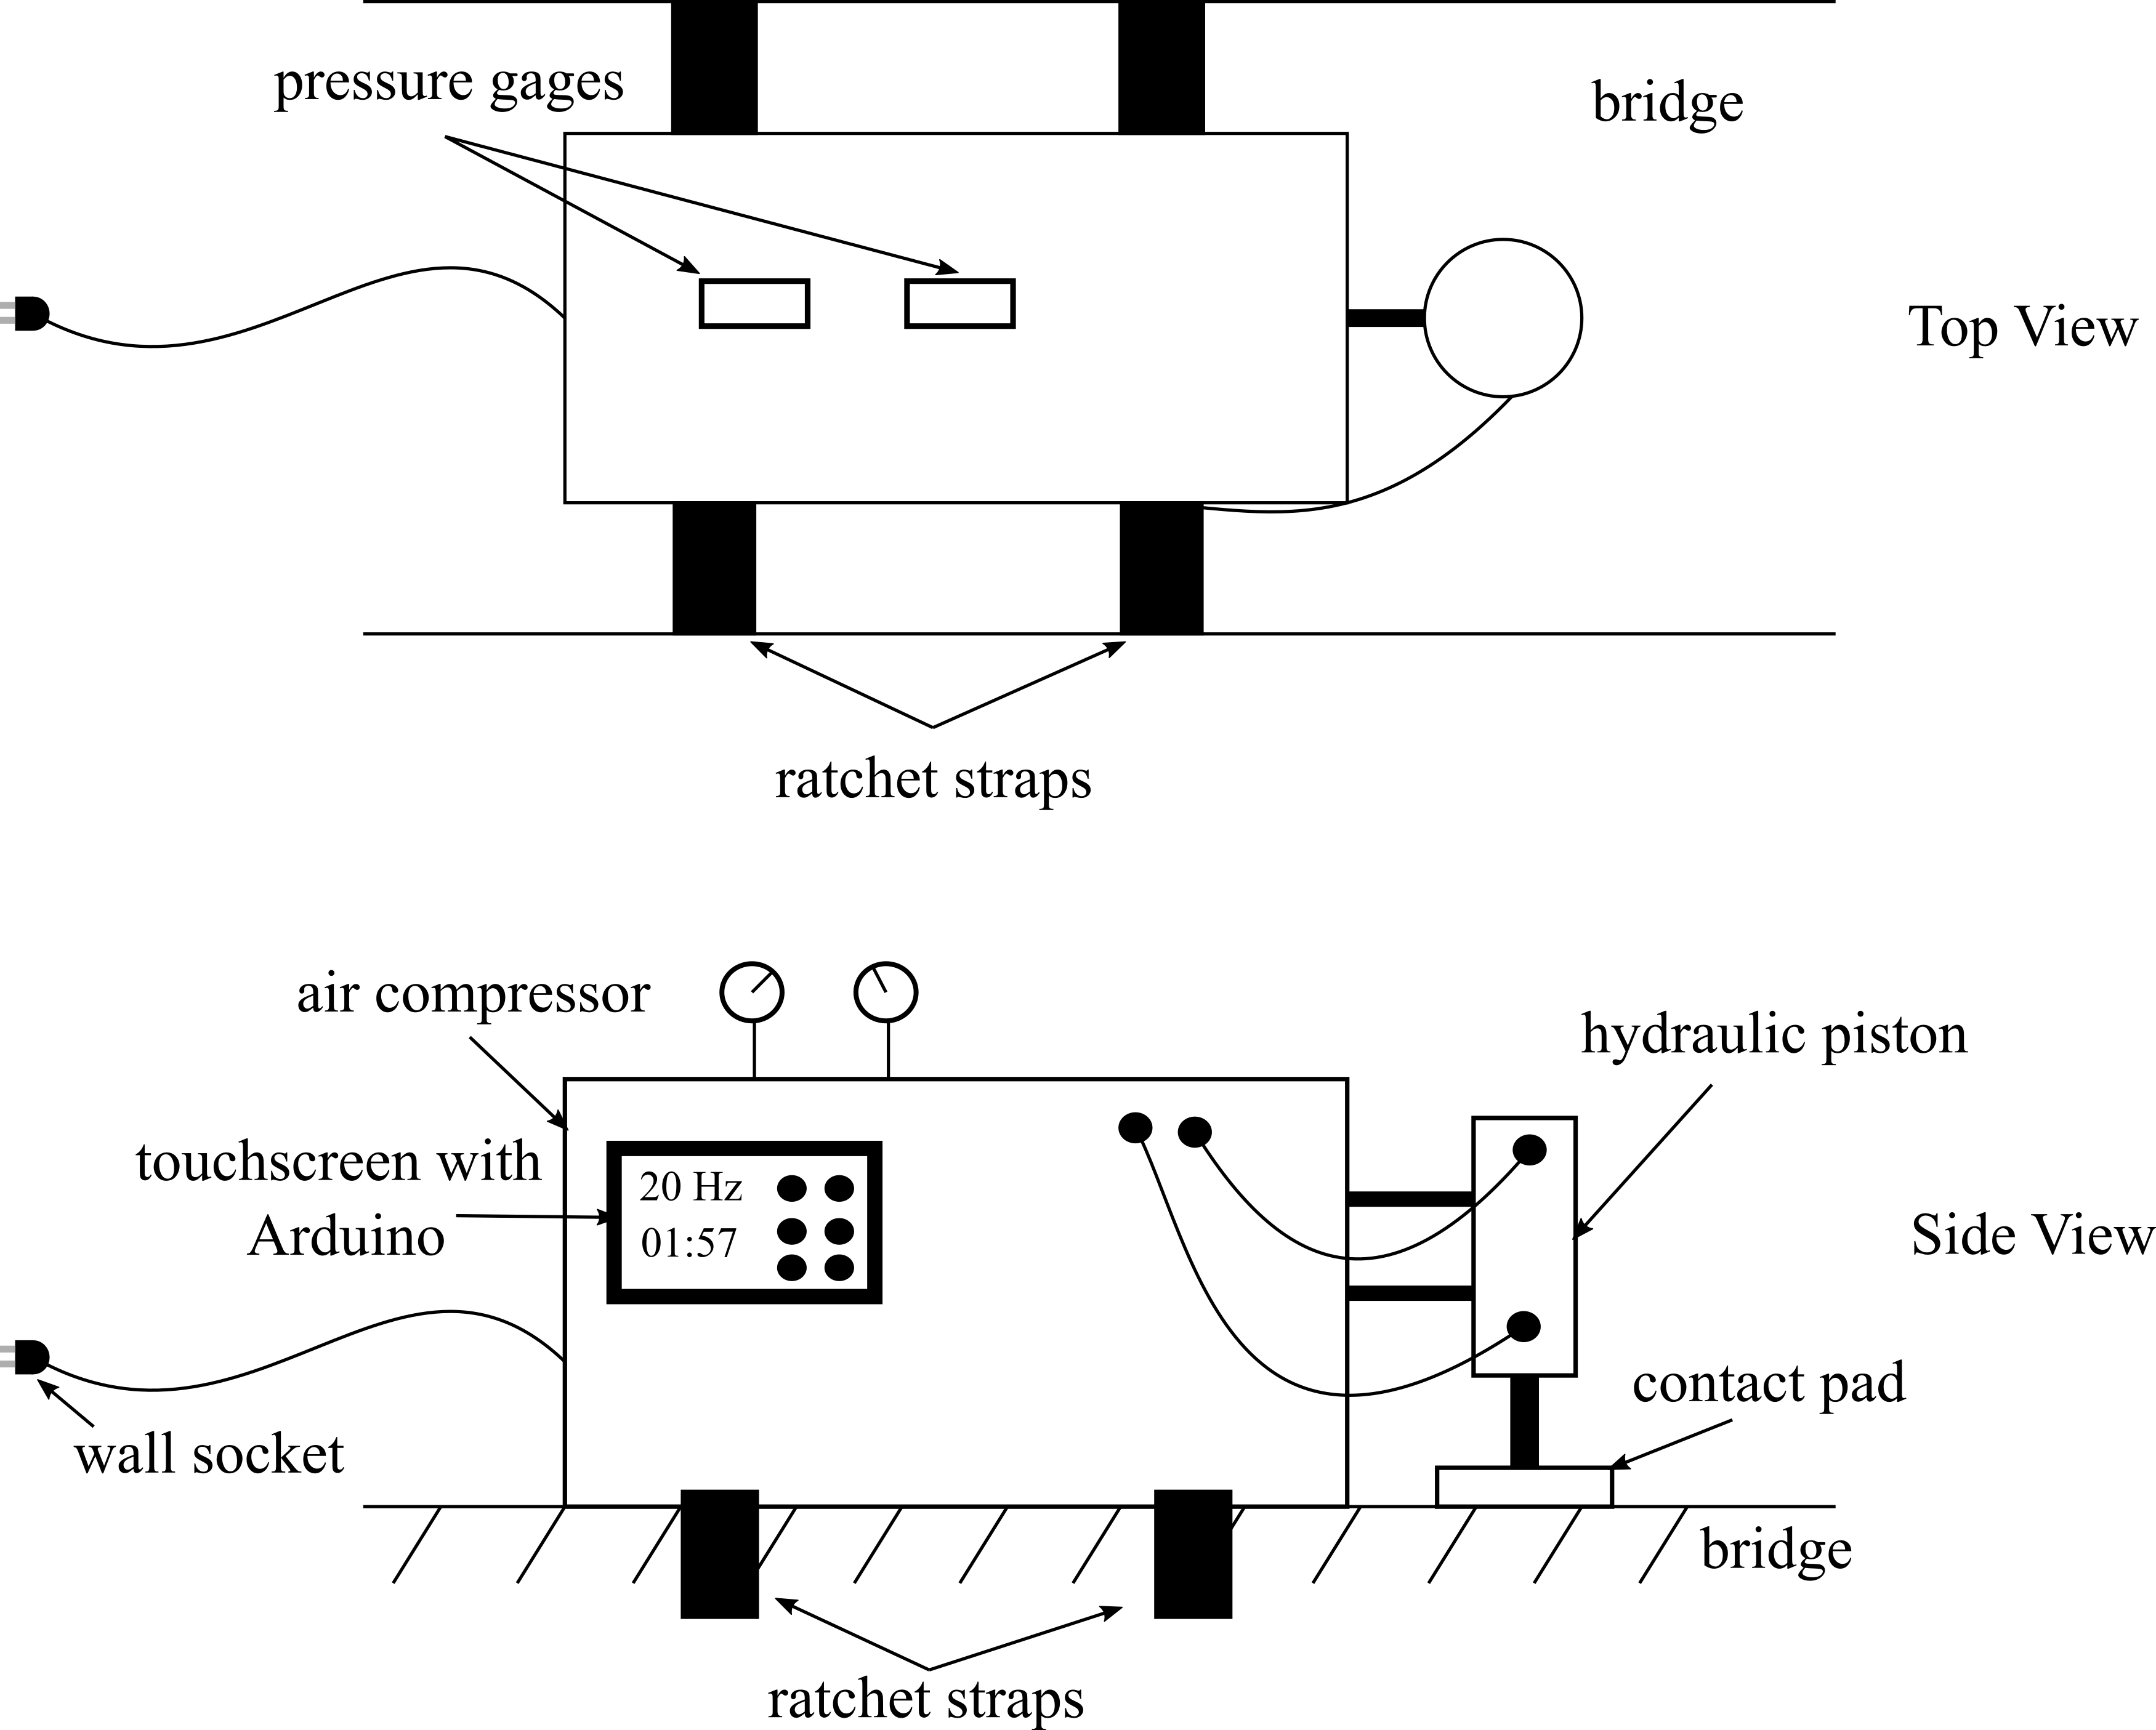
Concept 4
Strengths:
Operation at different frequencies
Resolution of at least 1 Hz
Contact to bridge
Weaknesses:
Robustness
Portability
Leaves bridge undamaged
Cost-effectiveness

Slide 18
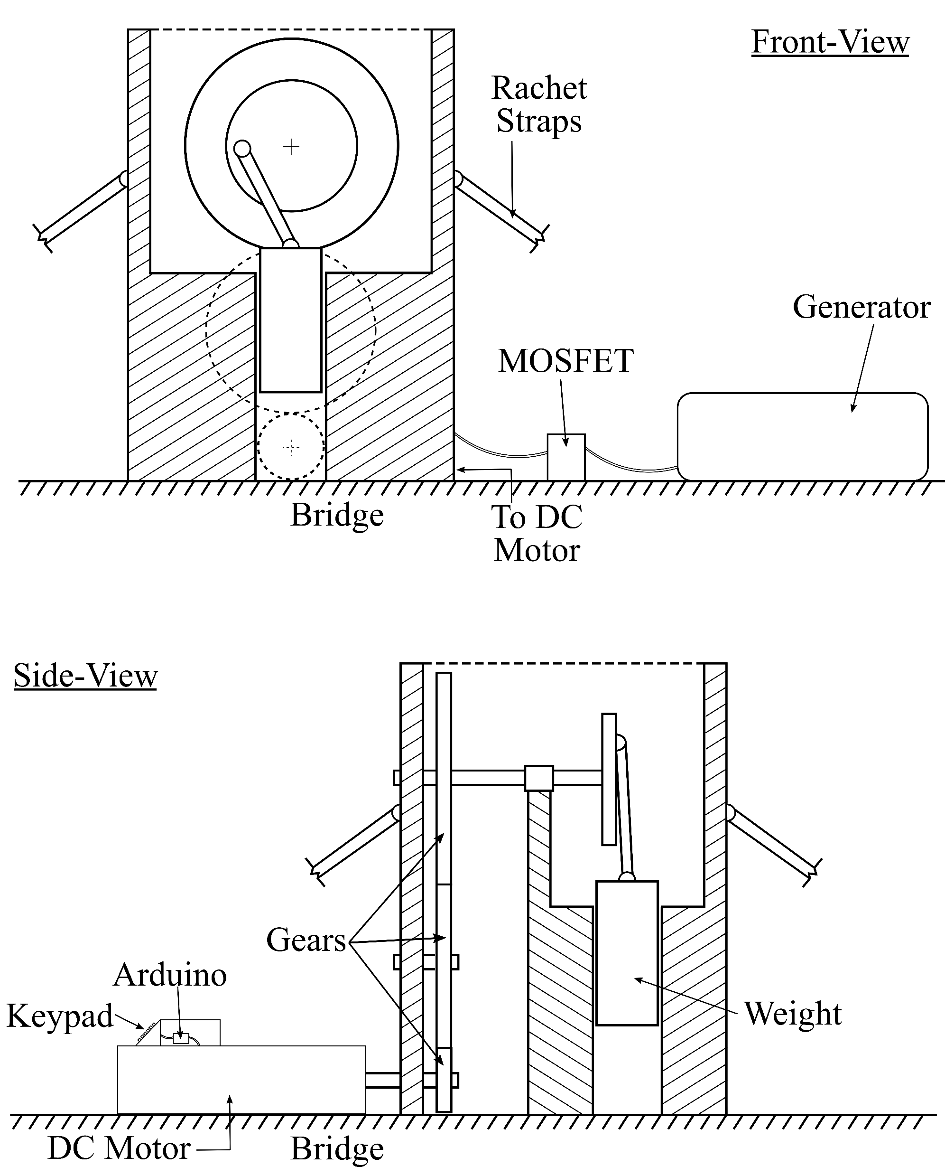
Concept 5
Strengths:
Robustness
Leaves bridge undamaged
Operation at different frequencies
Clear and safe operation
Weaknesses:
Usability after project
Cost-effectiveness

Slide 19
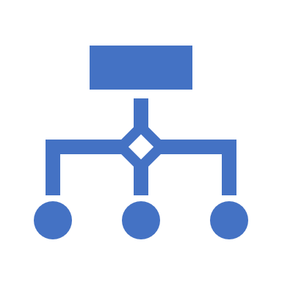
Concept Selection
The concept selection process was broken down into two sections:
Screening process
Concept Ranking
The top concept was selected to be the final concept

Slide 20
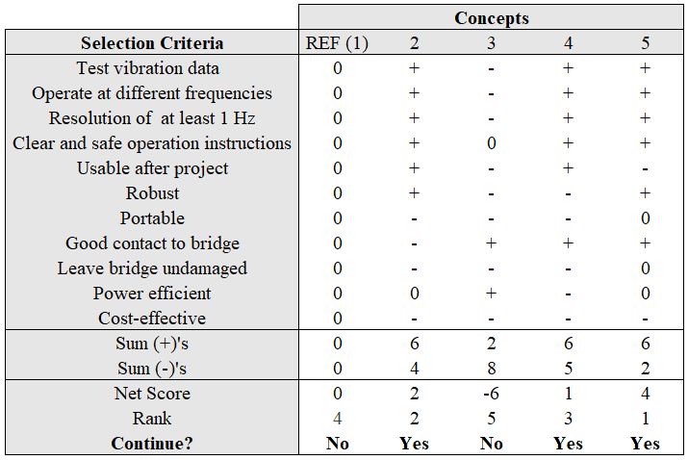
Concept Screening
Concept 1 was chosen as the reference concept
The other concepts are then compared to the reference based on the selection criteria
‘+’ signifies better execution
‘-’ signifies worse execution
The concepts were then ranked, and the top three concepts moved forward

Slide 21
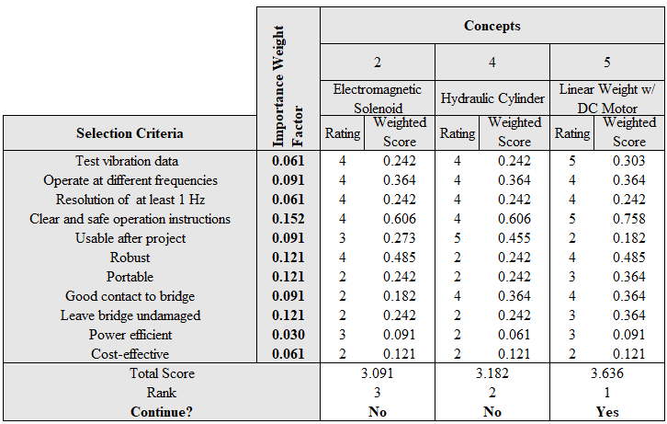
Concept Ranking
Top three concepts are ranked with weight factors
Weight factors are assigned based on the values determined from the product specifications report
Weight factors were normalized values from the Needs Metrics matrix
Concepts are ranked on a scale of 1-5 (5 being the best)
Final concept is chosen based on this ranking

Slide 22
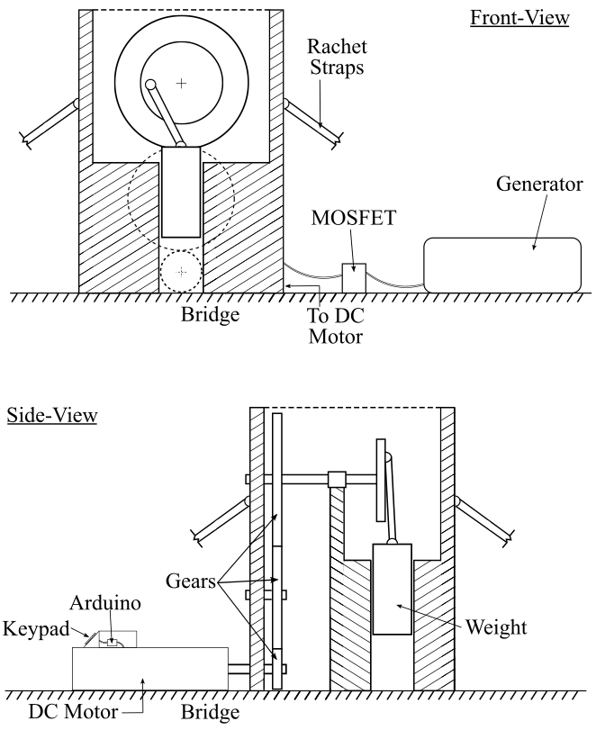
Final Concept
Concept 5
Linear weight powered by a DC motor
This concept scored highest in both tables
Two standout features:
Ability to test vibration data at a wide range of values
Ability to transfer energy more efficiently to the bridge

